Slide 1
Named Entity Recognition in emails
Burdescu alexandru
Stoleru vlad-Stefan
406, software engineering, fmi

Slide 2
What is Named Entity Recognition?
- subtask of information extraction that seeks to locate and classify named entities found in unstructured text into predefined categories:
Person names
Organization names
Geographical entities (locations)
Time indicators
Events (Public, restricted, historical)
Natural phenomena
- a named entity is a real-world object that falls into one of the beforementioned categories, which can be denoted with a proper name; it can also be considered an instance of the respective entity

Slide 3
Importance of NER in different scenarios
Content classification for news providers
Automatic content tagging
Efficient search algorithms
Content recommendations – Relevant Advertising
Handling of Customer Support Cases
Detection of PII and other sensitive information in shared data

Slide 4
Importance of NER in emails
Any email, casually or professionally written, can include information that is intended exclusively to the receiver and could otherwise cause damages, directly or indirectly, for the involved parties if the shared content is leaked
Sensitive information should redacted whenever the contents of an email are shared, verbally or written, with external parties
Using NER, pieces of information can be labeled and further removed if their classes denote sensitive content; Example: Personal Identifiable Information (PII)

Slide 5
Redacting Named Entities in emails
Dataset used: processed version of the Annotated Corpus for Named Entity Recognition (https://www.kaggle.com/abhinavwalia95/entity-annotated-corpus)
We use a recurrent NN to classify tokenized sentences into one of the following categories:
General information
Geographical names
Persons
Organizations
Time indicators
Artifacts
Natural phenomena
Events
Based on their classification, words are replaced with a generic value indicating their entity category

Slide 6
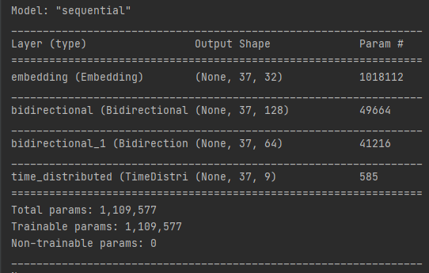
Model summary

Slide 7
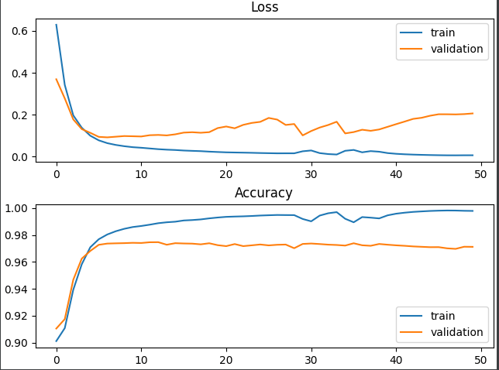
Performance metrics
Loss & Accuracy after 50 epochs on a 80-20 split

Slide 8
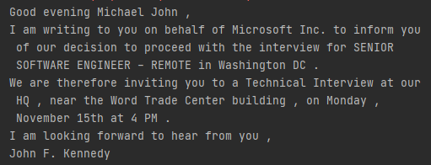
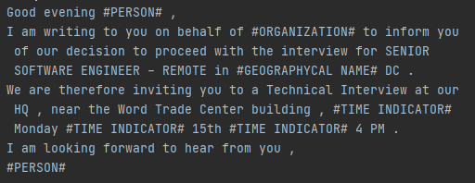
Example
Initial email
Redacted email

Slide 9
Thank you!

